Slide 1
Introduction to
SQL

Slide 2
What is SQL?
Structured Query Language
SQL is Structured Query Language, which is a computer language for storing, manipulating and retrieving data stored in relational database.
SQL is the standard language for Relation Database System. All relational database management systems like “MySQL, MS Access, Oracle, Sybase, Informix, postgres and SQL Server” use SQL as standard database language.

Slide 3
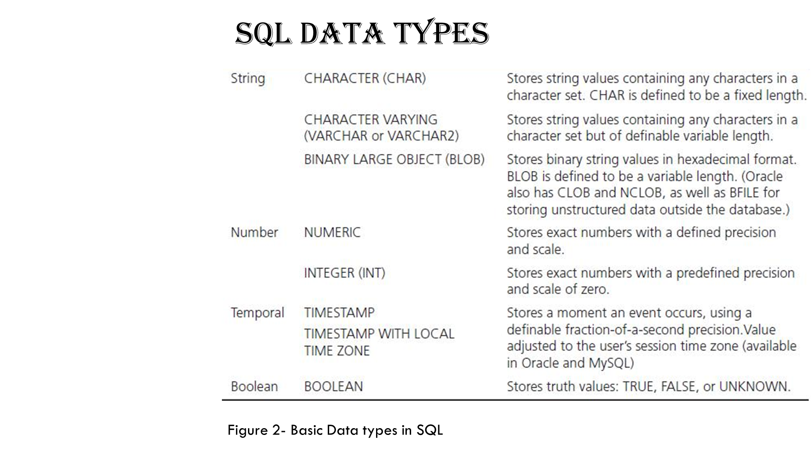

Slide 4
SQL Commands
DDL - Data Definition Language
DML - Data Manipulation Language
DCL - Data Control Language
DQL - Data Query Language

Slide 5
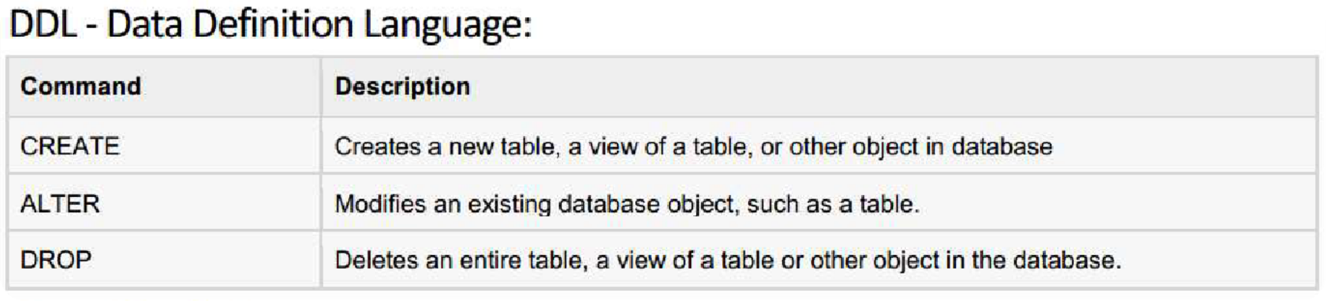

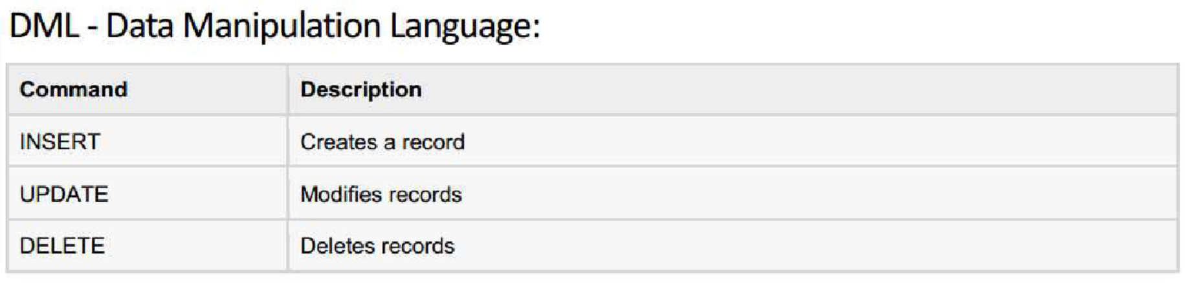
SQL Commands

Slide 6
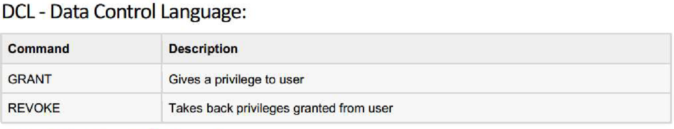

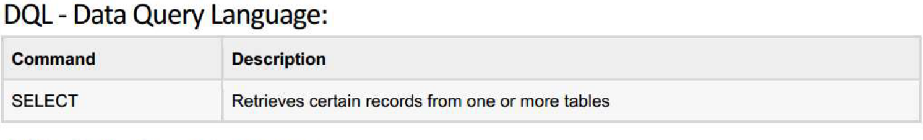

SQL Commands

Slide 7
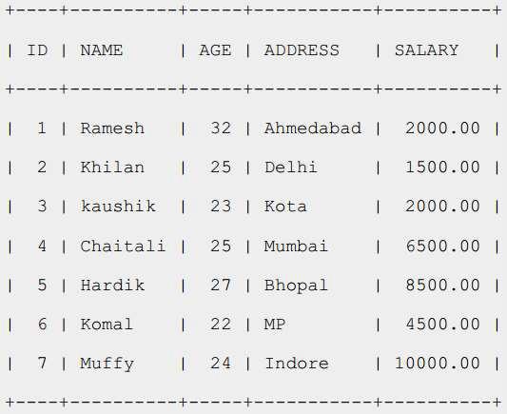
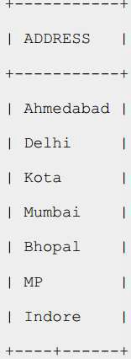
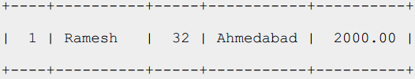
SQL RDBMS Concepts
TABLE
RECORD
COLUMN
CELL

Slide 8
SQL RDBMS Concepts
SQL Constraints: (applied on columns)
NOT NULL Constraint
UNIQUE Constraint
PRIMARY Key
FOREIGN Key
CHECK Constraint
Data Integrity:
Entity Integrity: There are no duplicate rows in a table
Domain Integrity: Enforces valid entries for a given column by restricting the type
Referential Integrity: Rows cannot be deleted which are used by other records
User-Defined Integrity: Enforces some specific business rules

Slide 9
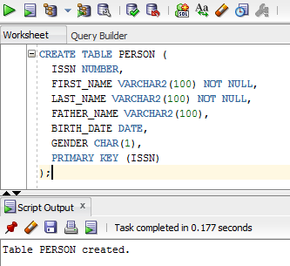
SQL : DDL
Create Table:
COLUMNS
CONSTRAINTS
CREATE TABLE phone
(
Phone int primary key,
ISSN int,
FOREIGN KEY (ISSN) REFERENCES Persons(ISSN)
);

Slide 10
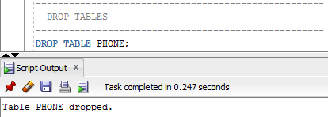
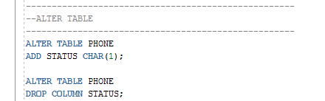
SQL: DDL
DROP TABLE:
ALTER TABLE

Slide 11
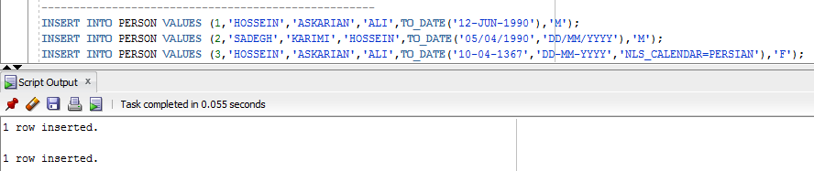
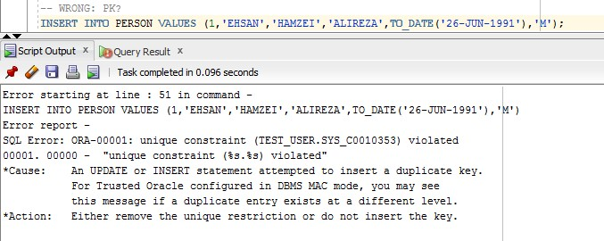
SQL: DML: INSERT
INSERT INTO:
NUMBER, CHAR/VARCHAR2, DATE?

Slide 12

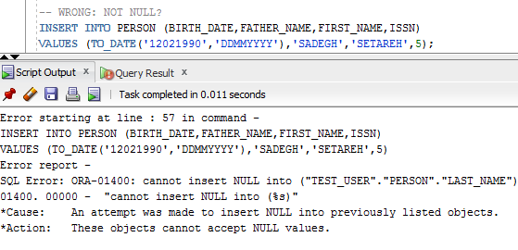
SQL: DML: INSERT
INSERT INTO:
SPECIFIC COLUMNS

Slide 13
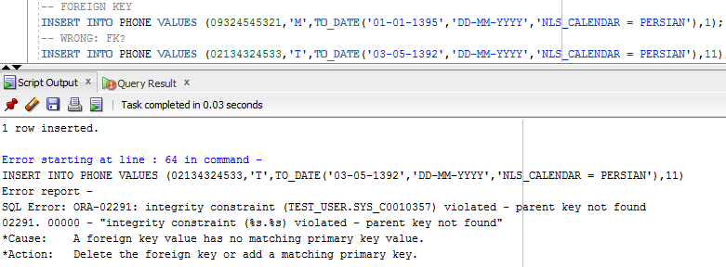
SQL: DML: INSERT
INSERT INTO:
FOREIGN KEY
ALL DML COMMANDS NEED COMMIT

Slide 14
Classwork:
Department and Employee Entity
D_id | D_name
101 | Finance
102 | Accounting
103 | IT
E_id | E_name | E_salary | D_id
1 | Zara | 45000 | 101
2 | John | 38000 | 101
3 | Akash | 42000 | 101
4 | Sindu | 48000 | 102
5 | Gopal | 36000 | 102
6 | Peter | 45000 | 102
7 | Sam | 40000 | 103
8 | Satish | 34000 | 103

Slide 15
Question: 1.Create department and Employee table and attributes. 2. Insert 5 values into each table department and Employee, respectively. 3. Add new column to employee table as address 5. Add values to address column 6. Remove the record from employee table whose cid is 7 7. Display the record of employee whose id is 4

Slide 16
8.Display the record of employee whose name start with letter ‘S’ 9.Display the record of employee whose course id is 101 and 102 using in clause 10.Display the record of employee by sorting in ascending order of marks column 11.Calculate average, sum and max marks of employee. 12.Calculate average, sum and max marks of student by department

Slide 17
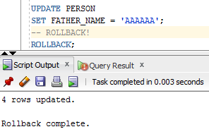
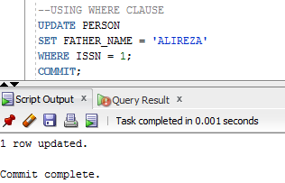
SQL: DML: UPDATE
UPDATE
WHERE CLAUSE

Slide 18
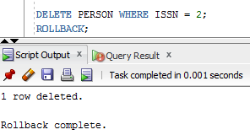
SQL: DML: DELETE
DELETE

Slide 19
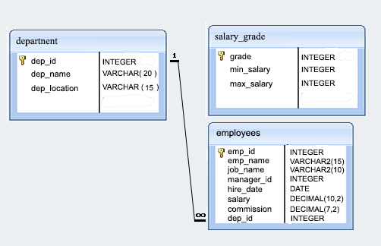

Slide 20


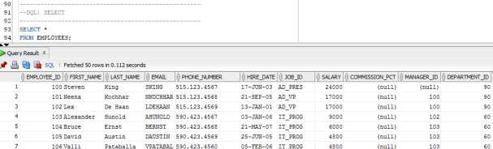
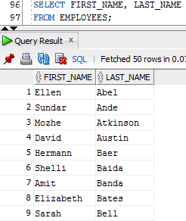
SQL: DQL: SELECT
SELECT
*
SPECIFIC COLUMNS

Slide 21

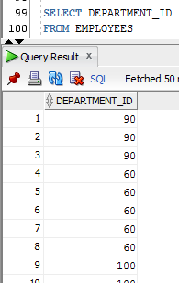
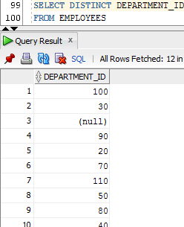
SQL: DQL: SELECT
DISTINCT CLUASE

Slide 22


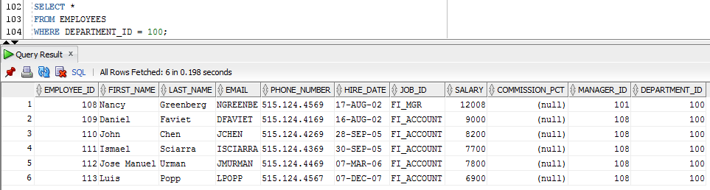


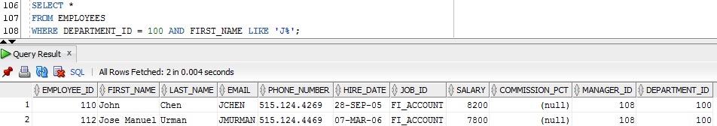
SQL: DQL: SELECT
WHERE CLUASE

Slide 23
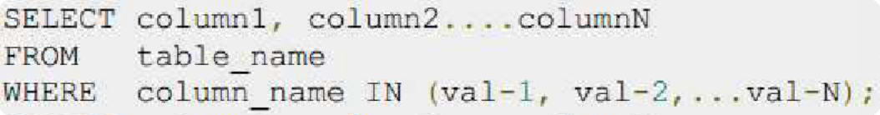

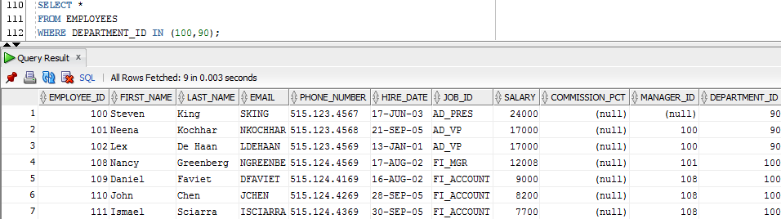
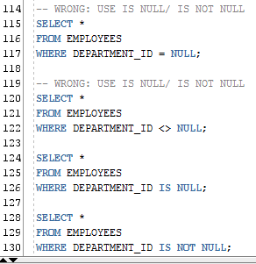
SQL: DQL: SELECT
IN CLUASE
NOT IN
NULL IN WHERE?
IS NULL
IS NOT NULL

Slide 24
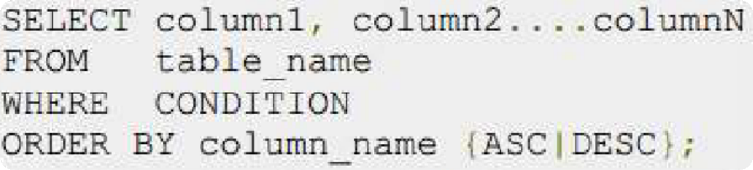

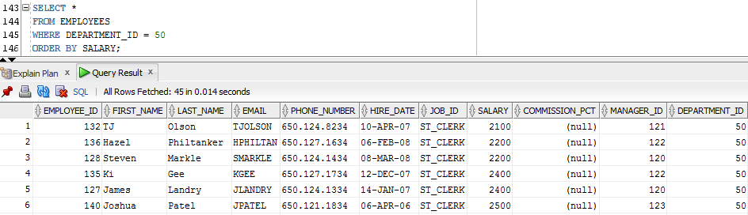
SQL: DQL: SELECT
ORDER BY

Slide 25
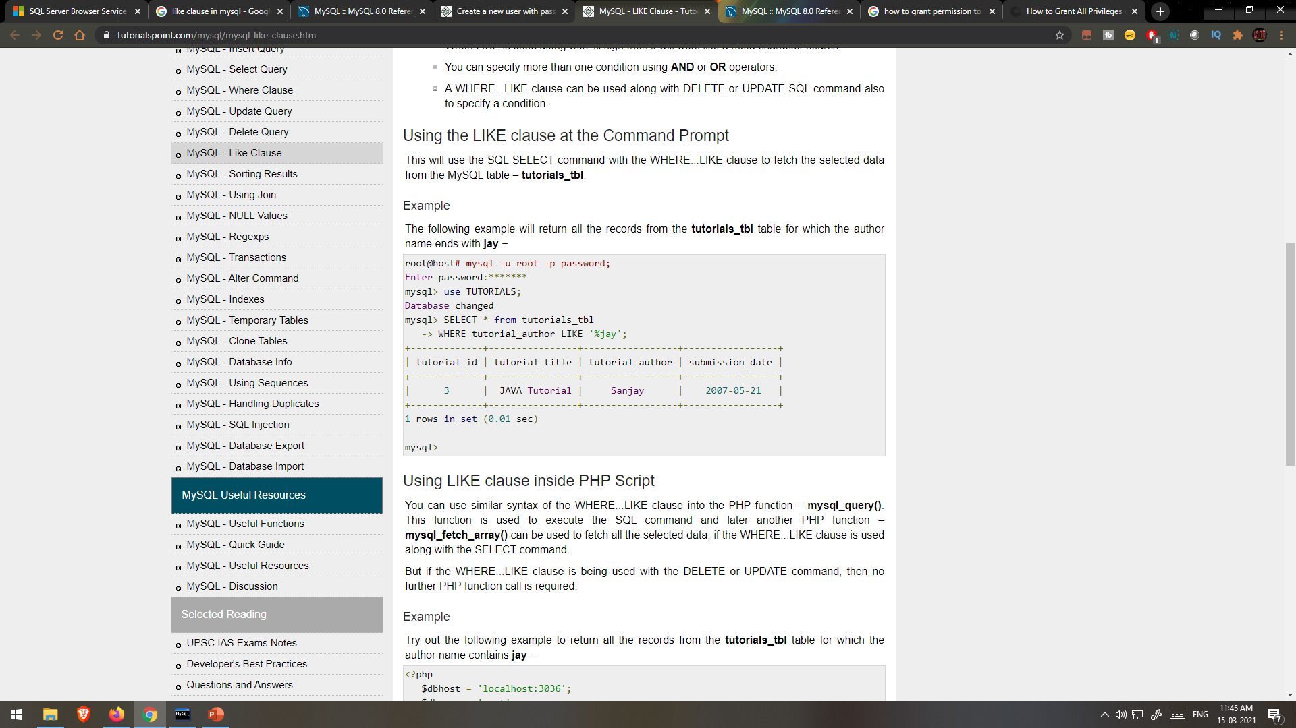
LIKE Clause

Slide 26
SQL: DQL: SELECT
GROUP BY
AGGREGATE FUCTION
MAX,MIN
AVG
COUNT
SUM

Slide 27
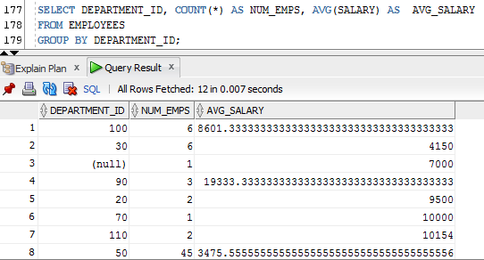

Slide 28
Below is a selection from the "Customers" table in the Northwind sample database:
CustomerID | CustomerName | ContactName | Address | City | PostalCode | Country
1 | Alfreds Futterkiste | Maria Anders | Obere Str. 57 | Berlin | 12209 | Germany
2 | Ana Trujillo Emparedados y helados | Ana Trujillo | Avda. de la Constitución 2222 | México D.F. | 05021 | Mexico
3 | Antonio Moreno Taquería | Antonio Moreno | Mataderos 2312 | México D.F. | 05023 | Mexico
4 | Around the Horn | Thomas Hardy | 120 Hanover Sq. | London | WA1 1DP | UK
5 | Berglunds snabbköp | Christina Berglund | Berguvsvägen 8 | Luleå | S-958 22 | Sweden

Slide 29
SELECT COUNT(CustomerID), Country FROM Customers GROUP BY Country;
COUNT(CustomerID) | Country
3 | Argentina
2 | Austria
2 | Belgium
9 | Brazil
3 | Canada
2 | Denmark
2 | Finland
11 | France

Slide 30
SELECT COUNT(CustomerID), Country
FROM Customers
GROUP BY Country
ORDER BY COUNT(CustomerID) DESC;

Slide 31
COUNT(CustomerID) | Country
13 | USA
11 | France
11 | Germany
9 | Brazil
7 | UK
5 | Spain
5 | Mexico
4 | Venezuela
3 | Canada
3 | Argentina
3 | Italy
2 | Denmark
2 | Sweden
2 | Finland
2 | Switzerland
2 | Austria
2 | Portugal
2 | Belgium

Slide 32
MySQL ALTER TABLE Statement
The ALTER TABLE statement is used to add, delete, or modify columns in an existing table.
The ALTER TABLE statement is also used to add and drop various constraints on an existing table.
ALTER TABLE - ADD Column
To add a column in a table, use the following syntax:
ALTER TABLE table_name
ADD column_name datatype;
The following SQL adds an "Email" column to the "Customers" table:
Example:
ALTER TABLE Customers
ADD Email varchar(255);

Slide 33
ALTER TABLE - DROP COLUMN
To delete a column in a table, use the following syntax (notice that some database systems don't allow deleting a column):
ALTER TABLE table_name
DROP COLUMN column_name;
The following SQL deletes the "Email" column from the "Customers" table:
Example
ALTER TABLE Customers
DROP COLUMN Email;
ALTER TABLE - MODIFY COLUMN
To change the data type of a column in a table, use the following syntax:
ALTER TABLE table_name
MODIFY COLUMN column_name datatype;

Slide 34
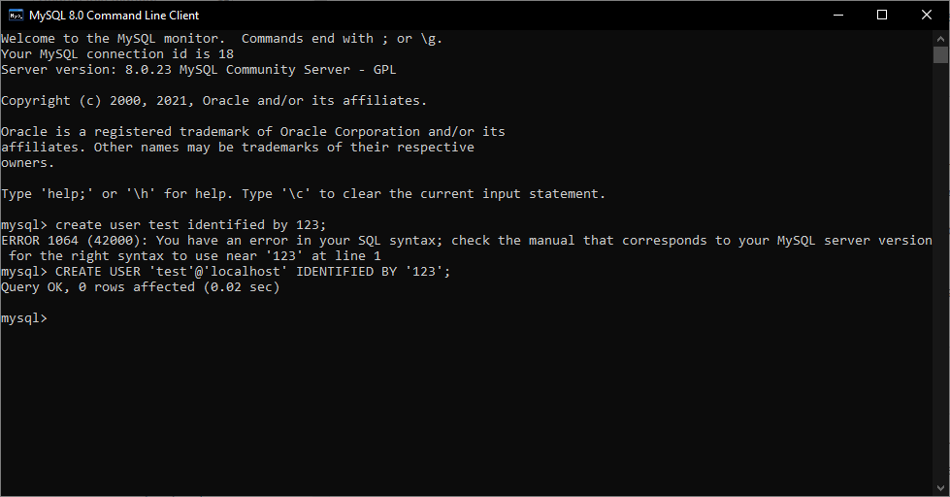
DCL: CREATE USER
1) Define User with Username/Password
2) Grants Sufficient Privileges.

Slide 35
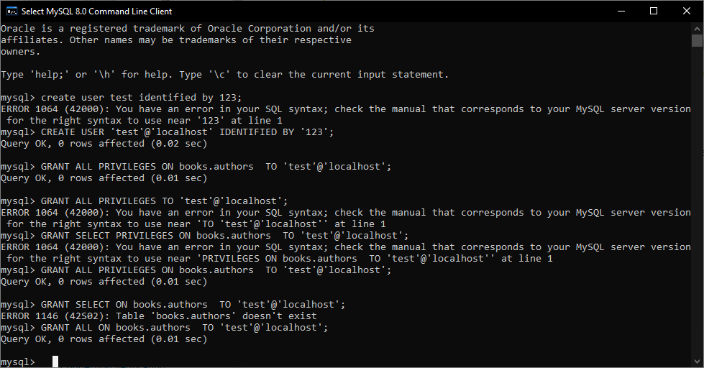

Slide 36
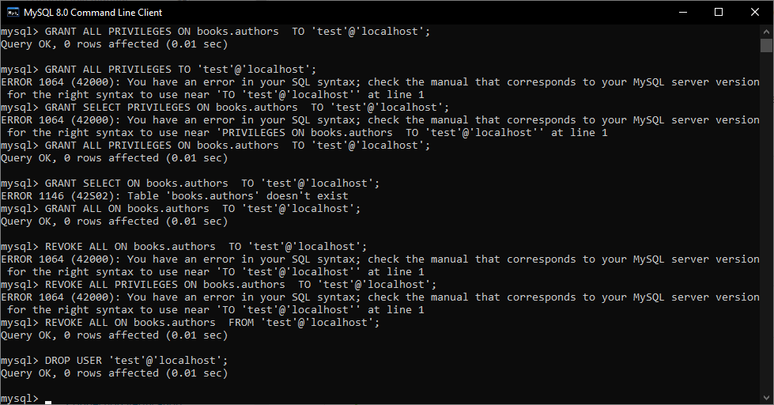
Online Compiler:
https://paiza.io/projects/p1M_17ebkKK5hqnv9-4OZQ?language=mysql

Slide 37
Other database objects VIEWS Sequences

Slide 38
Creating Views
Database views are created using the CREATE VIEW statement.
Views can be created from a single table, multiple tables or another view.
To create a view, a user must have the appropriate system privilege according to the specific implementation.
The basic CREATE VIEW syntax is as follows −
CREATE VIEW view_name AS
SELECT column1, column2.....
FROM table_name
WHERE [condition];

Slide 39
Example
Consider the CUSTOMERS table having the following records −
+----+----------+-----+-----------+----------+
| ID | NAME | AGE | ADDRESS | SALARY |
+----+----------+-----+-----------+----------+
| 1 | Ramesh | 32 | Ahmedabad | 2000.00 |
| 2 | Khilan | 25 | Delhi | 1500.00 |
| 3 | kaushik | 23 | Kota | 2000.00 |
| 4 | Chaitali | 25 | Mumbai | 6500.00 |
| 5 | Hardik | 27 | Bhopal | 8500.00 |
| 6 | Komal | 22 | MP | 4500.00 |
| 7 | Muffy | 24 | Indore | 10000.00 |
+----+----------+-----+-----------+----------+
Following is an example to create a view from the CUSTOMERS table. This view would be used to have customer name and age from the CUSTOMERS table.
SQL > CREATE VIEW CUSTOMERS_VIEW AS
SELECT name, age
FROM CUSTOMERS;

Slide 40
Now, you can query CUSTOMERS_VIEW in a similar way as you query an actual table. Following is an example for the same.
SQL > SELECT * FROM CUSTOMERS_VIEW;
This would produce the following result.
+----------+-----+
| name | age |
+----------+-----+
| Ramesh | 32 |
| Khilan | 25 |
| kaushik | 23 |
| Chaitali | 25 |
| Hardik | 27 |
| Komal | 22 |
| Muffy | 24 |
+----------+-----+

Slide 41
Dropping Views
Obviously, where you have a view, you need a way to drop the view if it is no longer needed. The syntax is very simple and is given below −
DROP VIEW view_name;
Following is an example to drop the CUSTOMERS_VIEW from the CUSTOMERS table.
DROP VIEW CUSTOMERS_VIEW;

Slide 42
MySQL SEQUENCE
A sequence in MySQL is an arrangement of integers generated in the ascending order (1, 2, 3, and so on) on specific demand.
Sequences are used in the databases to generate unique numbers.
Many applications require each row of a table to contain a distinct value, such as student roll number in student_table, employee numbers in HR, customer ID in CRM, etc. To fulfill this type of arrangement, we use sequences that provide an easy way to generate them.
Note :
MySQL does not provide any built-in function to create a sequence for a table's rows or columns. But we can generate it via SQL query.

Slide 43
The simplest way for creating a sequence in MySQL is by defining the column as AUTO_INCREMENT during table creation, which should be a primary key column.
Execute the below query to create a table:
mysql> CREATE TABLE Insects (
Id INT UNSIGNED NOT NULL AUTO_INCREMENT, PRIMARY KEY (id), Name VARCHAR(30) NOT NULL,Type VARCHAR(30) NOT NULL,Origin VARCHAR(30) NOT NULL );
mysql> INSERT INTO Insects (Name, Type, Origin) VALUES ('Cockroach', 'Crawling', 'Kitchen’);

Slide 44
THANK YOU

